Slide 1
CS4104 Applied Machine Learning
Deep Learning

Slide 2
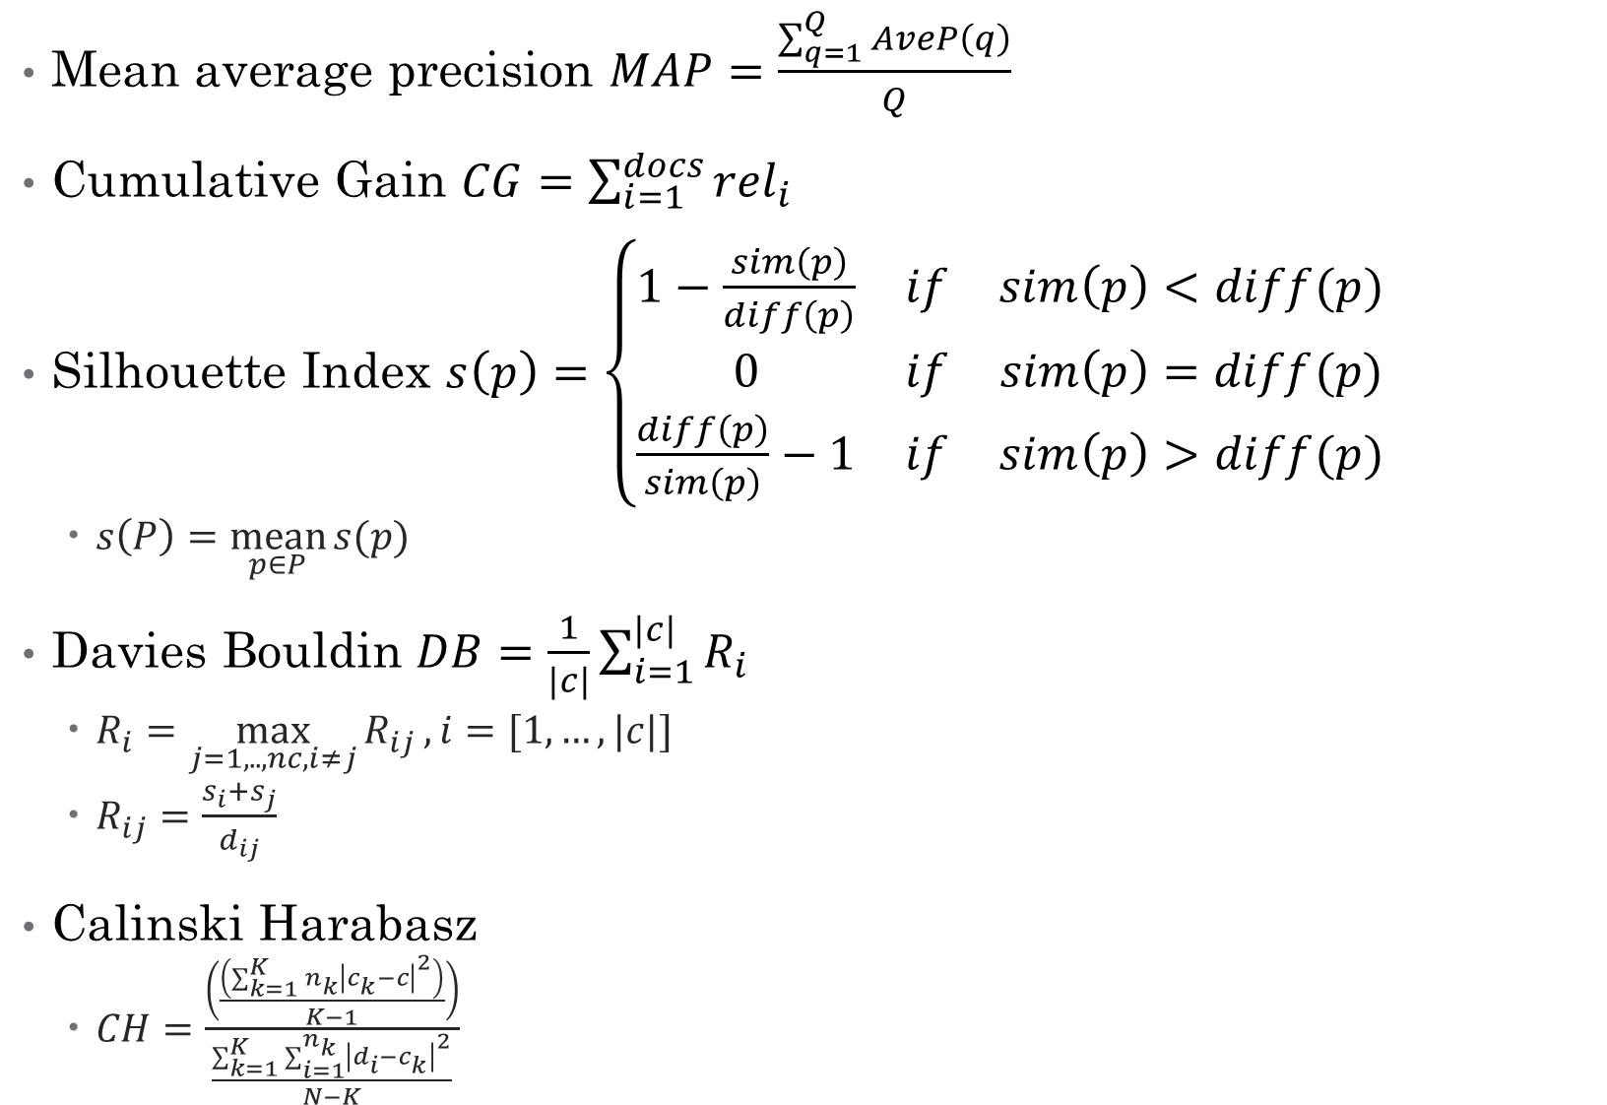
Mean average precision $MAP=\frac{\sum_{q=1}^{Q}{AveP\left(q\right)}}{Q}$
Cumulative Gain $CG=\sum_{i=1}^{docs}{rel_{i}}$
Silhouette Index $s\left(p\right)=\left\{\begin{matrix}1−\frac{sim\left(p\right)}{diff\left(p\right)} & if & sim\left(p\right)<diff(p) \\ 0 & if & sim\left(p\right)=diff(p) \\ \frac{diff\left(p\right)}{sim\left(p\right)}−1 & if & sim\left(p\right)>diff(p)\end{matrix}\right.$
$s\left(P\right)=\underset{p∈P}{mean}{s(p)}$
Davies Bouldin $DB=\frac{1}{|c|}\sum_{i=1}^{|c|}{R_{i}}$
$R_{i}=\max_{j=1,..,nc,i≠j}{R_{ij}},i=[1,…,|c|]$
$R_{ij}=\frac{s_{i}+s_{j}}{d_{ij}}$
Calinski Harabasz
$CH=\frac{\left(\frac{\left(\sum_{k=1}^{K}{n_{k}}{\left|c_{k}−c\right|}^{2}\right)}{K−1}\right)}{\frac{\sum_{k=1}^{K}{\sum_{i=1}^{n_{k}}{{\left|d_{i}−c_{k}\right|}^{2}}}}{N−K}}$

Slide 3
Machine Learning
Field of study that gives computers ability to learn
Machine learning is programming computers to optimize a performance criterion using example data or past experience.
There is no need to “learn” to calculate payroll
Learning is used when:
Human expertise does not exist (navigating on Mars),
Humans are unable to explain their expertise (speech recognition)
Solution changes in time (routing on a computer network)
Solution needs to be adapted to particular cases (user biometrics)

Slide 4
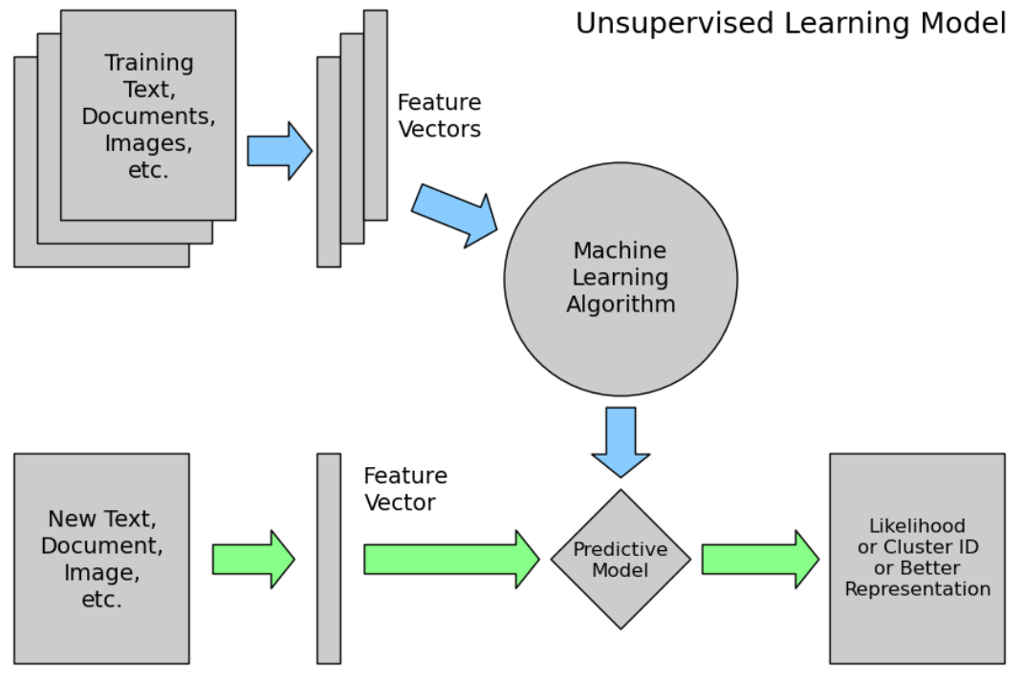
Un-Supervised Learning

Slide 5
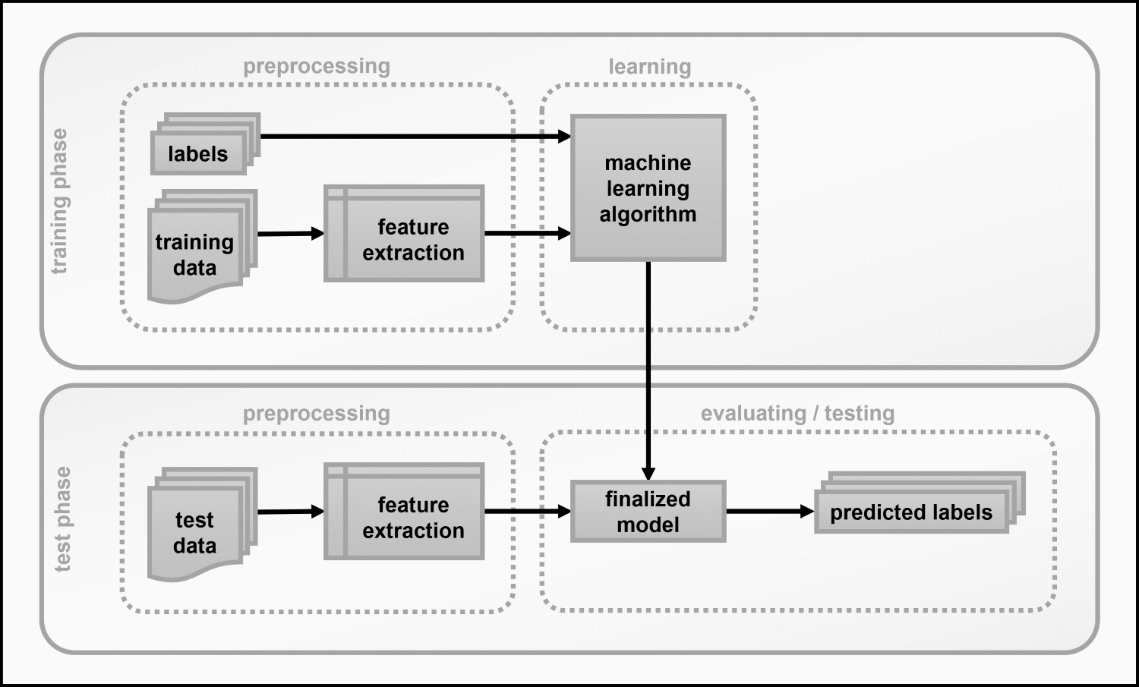
Supervised Learning

Slide 6
Image Features
Color Descriptors
Dominant color
Color Layout (essentially Primary color on block-by-block basis)
Scalable Color (essentially Color histogram)
Color Structure (essentially local Color histogram)
Color spaces to make things interoperable
Texture Features
Texture Browsing Descriptor - which defines granularity/coarseness, regularity, and direction.
Homogeneous Texture Descriptor - which is based on Gabor filter bank
Edge Histogram
Haralick Features
edge detectors
corner detectors
blob detectors
ridge detectors
Shape Descriptors
Region based descriptors are scalar attributes of shape under consideration - such as area, ecentricities etc.
Contour based which captures actual characteristic shape features
3D descriptors
Motion Descriptors for Video
Camera Motion (3-D camera motion parameters)
Motion Trajectory (of objects in the scene) [e.g. extracted by tracking algorithms] Parametric Motion (e.g. motion vectors, which allows description of motion of scene. But it can be more complex models on various objects).
Activity which is more of a semantic descriptor.
Local Binary and Ternary Patterns

Slide 7
Text Features
Text Vectorization
Text Frequencies
TF
IDF
TF-IDF
Bag of Words
Word Embedding
WordtoVec (Google)
Global Vectors or GloVe (Stanford)
fastText (Facebook)

Slide 8
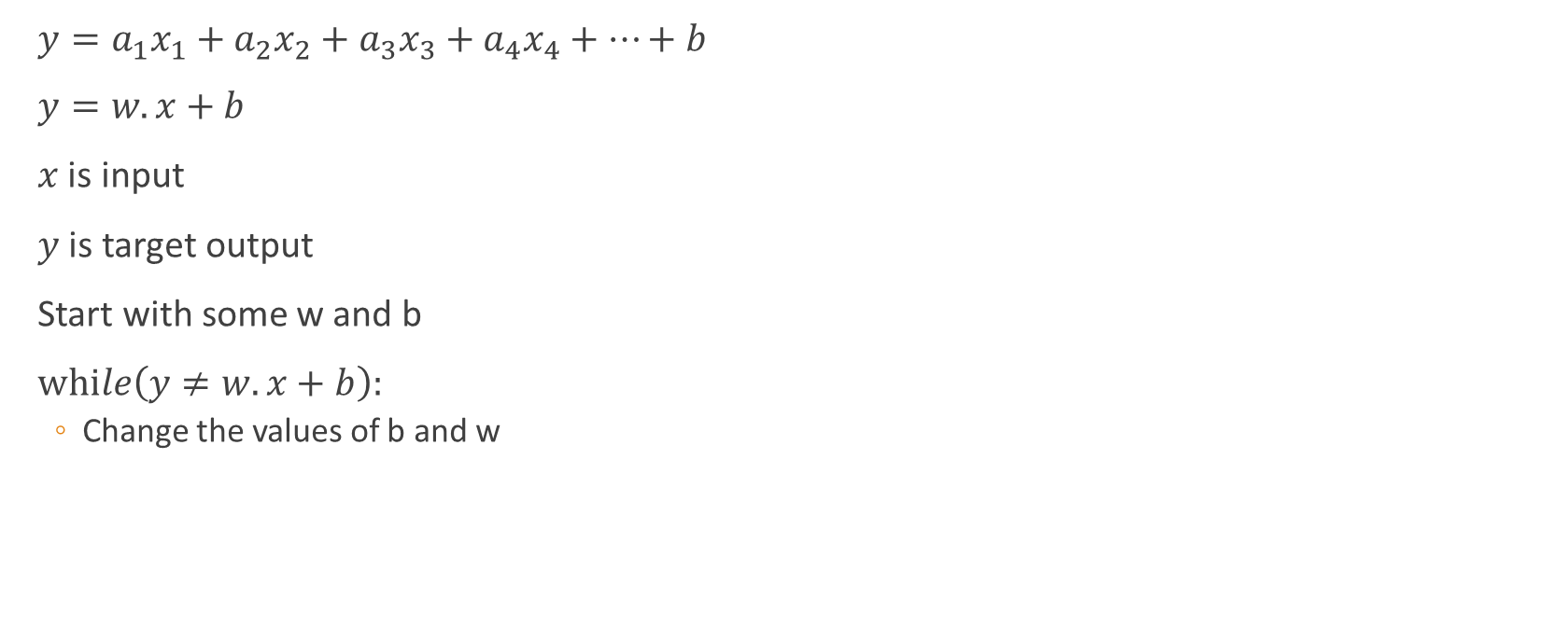
Learning by examples
$y=a_{1}x_{1}+a_{2}x_{2}+a_{3}x_{3}+a_{4}x_{4}+…+b$
$y=w.x+b$
$x$ is input
$y$ is target output
Start with some w and b
$while\left(y≠w.x+b\right):$
Change the values of b and w

Slide 9
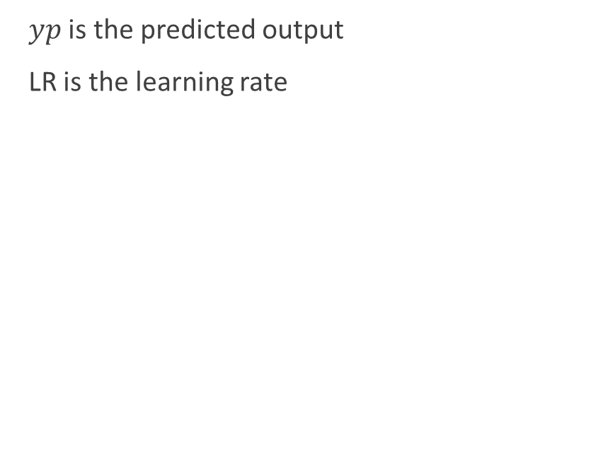
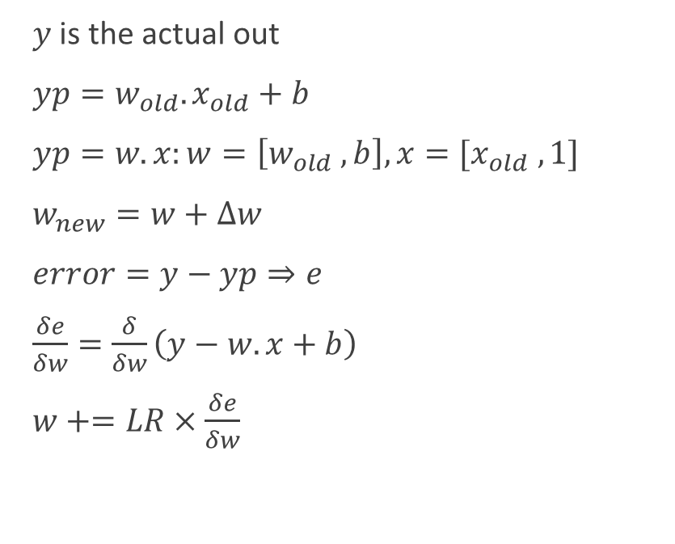
Gradient Descend
$y$ is the actual out
$yp=w_{old}.x_{old}+b$
$yp=w.x:w=\left[w_{old} , b\right], x=[x_{old} , 1]$
$w_{new}=w+∆w$
$error=y−yp⇒e$
$\frac{δe}{δw}=\frac{δ}{δw}\left(y−w.x+b\right)$
$w+=LR×\frac{δe}{δw}$
$yp$ is the predicted output
LR is the learning rate

Slide 10
Deep Learning
Hype: extravagant or intensive publicity or promotion
Hope: expectation of fulfillment or success
Yann LeCun quote: DNNs require: “an interplay between intuitive insights, theoretical modeling, practical implementations, empirical studies, and scientific analyses” (Turing Award: 2018)

Slide 11

“Traditional” machine learning:
handcrafted features
learned classifier
cat
Deep, “end-to-end” learning:
learned low-level features
learned mid-level features
learned high-level features
learned classifier
cat

Slide 12
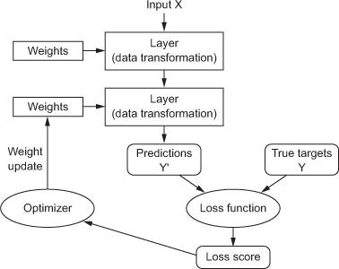
Anatomy of a deep neural network
Layers
Input data and targets
Loss function
Optimizer

Slide 13
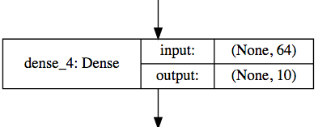
Layers
Data processing modules
Many different kinds exist
densely connected
Convolutional
Recurrent
pooling, flattening, merging, normalization
Input: one or more tensors output: one or more tensors
Usually have a state, encoded as weights
learned, initially random
When combined, form a network or a model

Slide 14
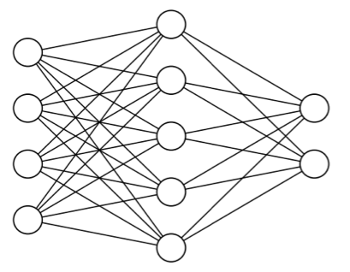
Input data and targets
The network maps the input data X to predictions Y′
During training, the predictions Y′ are compared to true targets Y using the loss function
cat
dog

Slide 15
Loss function
The quantity to be minimized (optimized) during training
the only thing the network cares about
there might also be other metrics you care about
Common tasks have “standard” loss functions:
mean squared error for regression
binary cross-entropy for two-class classification
categorical cross-entropy for multi-class classification

Slide 16
Optimizer
How to update the weights based on the loss function
Learning rate (+scheduling)
Stochastic gradient descent, momentum, and their variants
RMSProp is usually a good first choice
Animation from: https://imgur.com/s25RsOr
Notes:
RMSProp mentioned in Hinton’s lecture notes

Slide 17
Anatomy of a deep neural network

Slide 18











Frameworks for DL

Slide 19

Deep learning frameworks
Actually tools for defining static or dynamic general-purpose computational graphs
Automatic differentiation
Seamless CPU / GPU usage
multi-GPU, distributed
Python/numpy or R
Open source
+
+
✕
✕
x
y
5

Slide 20
Convolution Neural Networks
Image Classification
Image Segmentation OR Generation
LeNet (1998)
AlexNet (2012)
VGG16/VGG19 (2014)
Inception (2014)
Exception
ResNet (2015)
DenseNet (2017)
GANS
SegNet
Unet
Unet++
ResUNet

Slide 21
CS4104 Applied Machine Learning
Neural Networks with Timeline

Slide 22
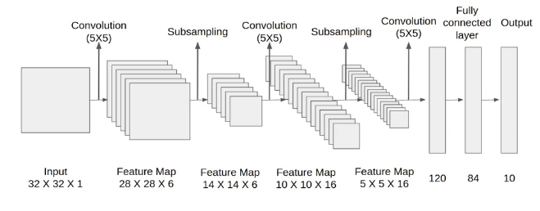
LeNet (Yann LeCun 1989)
Backpropagation Applied to Handwritten Zip Code Recognition
Subsampling/Max Pooling
Tested on
ZipCode
MNIST (0 to 9 digits)
From 2 Convolutions to 5 Convolutions

Slide 23
Convolution
For r in Rows:
For c in columns:
Res[r,c]=sum(img[r,c]*kernel)
2*1+4*2+9*3=37
2*-4+1*7+4*4=15
1*2+1*-5+2*1=-1
Total=51
2 | 4 | 9 | 1 | 4
2 | 1 | 4 | 4 | 6
1 | 1 | 2 | 9 | 2
7 | 3 | 5 | 1 | 3
2 | 3 | 4 | 8 | 5
1 | 2 | 3
-4 | 7 | 4
2 | -5 | 1
51
X
=
Kernel/Filter
Feature
Image
2 | 4 | 9 | 1 | 4
2 | 1 | 4 | 4 | 6
1 | 1 | 2 | 9 | 2
7 | 3 | 5 | 1 | 3
2 | 3 | 4 | 8 | 5
1 | 2 | 3
-4 | 7 | 4
2 | -5 | 1
51
66
X
=

Slide 24
Convolution
For r in Rows:
For c in columns:
Res[r,c]=sum(img[r,c]*kernel)
2 | 4 | 9 | 1 | 4
2 | 1 | 4 | 4 | 6
1 | 1 | 2 | 9 | 2
7 | 3 | 5 | 1 | 3
2 | 3 | 4 | 8 | 5
1 | 2 | 3
-4 | 7 | 4
2 | -5 | 1
51 | 66
X
=
31
Kernel/Filter
Feature
Image
2 | 4 | 9 | 1 | 4
2 | 1 | 4 | 4 | 6
1 | 1 | 2 | 9 | 2
7 | 3 | 5 | 1 | 3
2 | 3 | 4 | 8 | 5
1 | 2 | 3
-4 | 7 | 4
2 | -5 | 1
51 | 66
31
X
=
-2

Slide 25
Pooling
Combine pixels into a single pixel with
Max
Min
Average
2 | 4 | 9 | 1
2 | 1 | 4 | 4
1 | 1 | 2 | 9
7 | 3 | 5 | 1
4 | 9
7 | 9
Image/Source
Max Pooling (2*2)

Slide 26
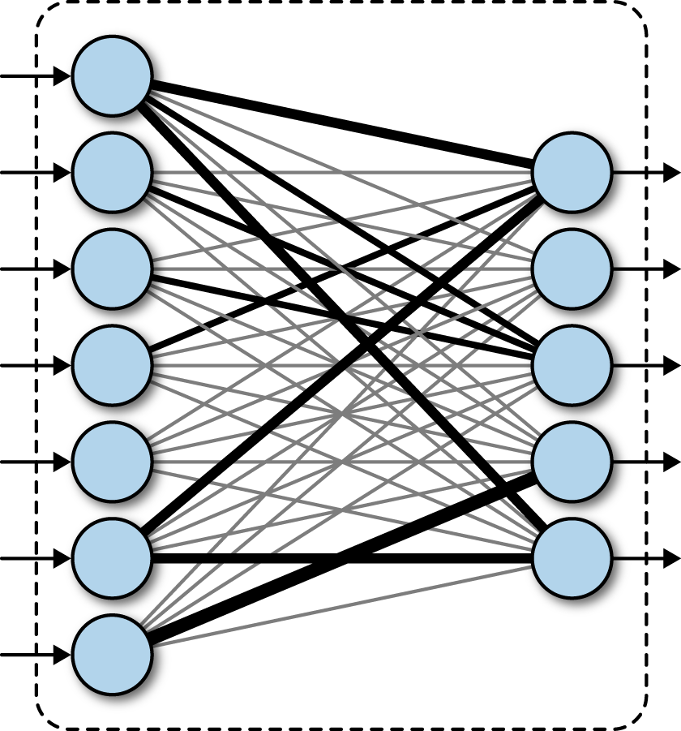
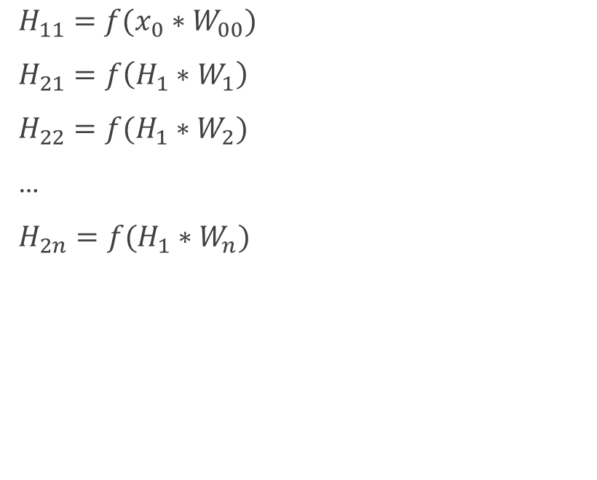
Fully Connected Layer
$H_{11}={f(x}_{0}∗W_{00})$
$H_{21}=f\left(H_{1}∗W_{1}\right)$
$H_{22}=f(H_{1}∗W_{2})$
…
$H_{2n}=f(H_{1}∗W_{n})$
H11
H12
H21
H13
H22
H14
H23
H15
H24
H16
H25
H17

Slide 27
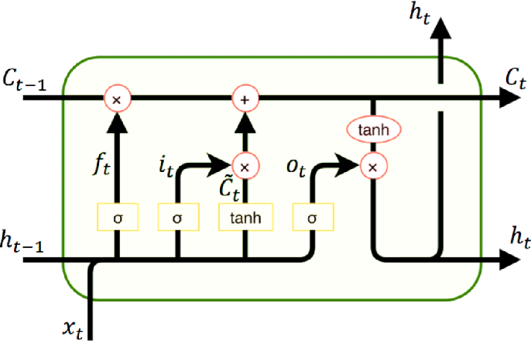
Recurrent Nets: LSTMs (1997)
Speech Recognition
Long Short-term Memory

Slide 28
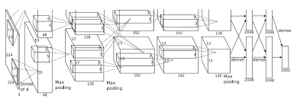
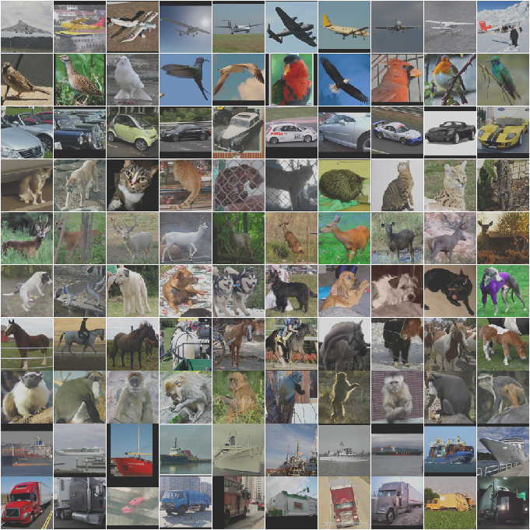
Convolutional NNs
AlexNet (2012)
ImageNet
Dataset Size 200 GB

Slide 29
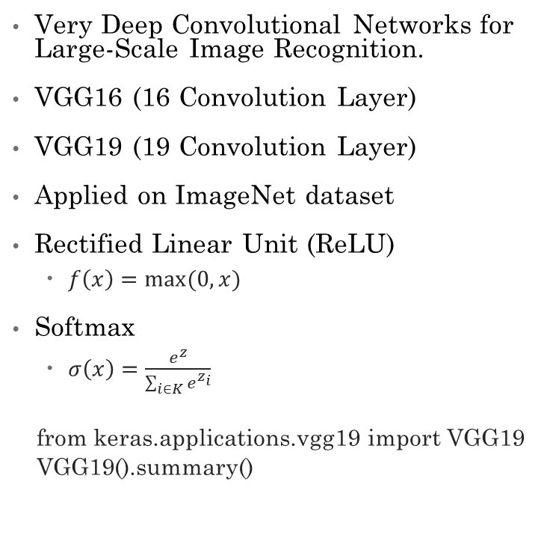
VGG (Visual Geometry Group)
Very Deep Convolutional Networks for Large-Scale Image Recognition.
VGG16 (16 Convolution Layer)
VGG19 (19 Convolution Layer)
Applied on ImageNet dataset
Rectified Linear Unit (ReLU)
$f\left(x\right)=max⁡(0,x)$
Softmax
$σ\left(x\right)=\frac{e^{z}}{\sum_{i∈K}{e^{z_{i}}}}$
from keras.applications.vgg19 import VGG19
VGG19().summary()
Convolution Layers
Convolution2D
ReLU
Max Pooling2D
Fully Connected Layers
Dense (4096)
ReLU
Dense (4096)
ReLU
Dense (1000)
Softmax
Input (224*224*3)
Output (1000)
Parameters: 143,667,240 (VGG19) [Mostly at FC]

Slide 30
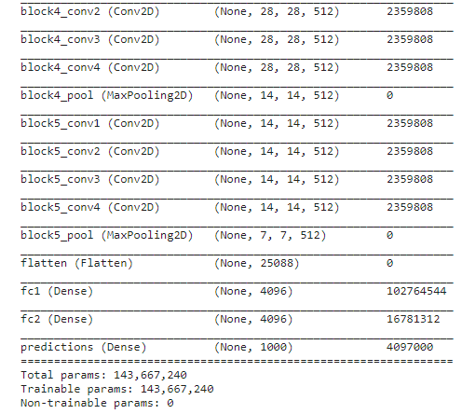
Parameters

Slide 31
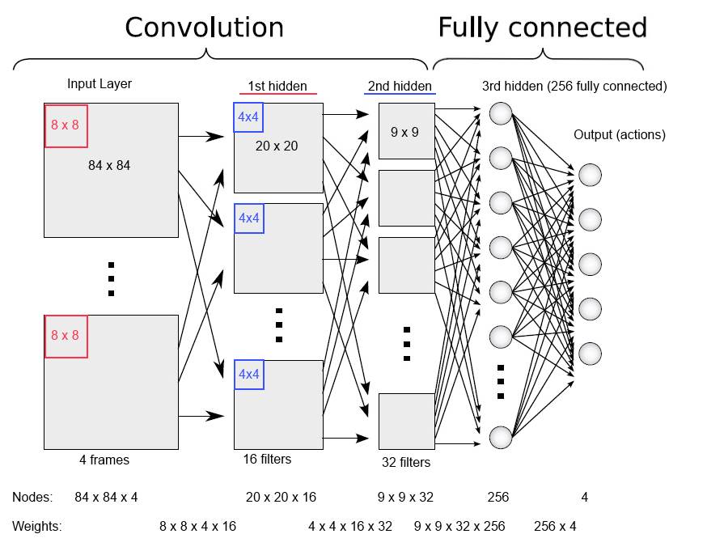
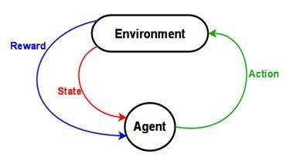
Deep Mind: Reinforcement Learning
Deep Reinforcement Learning
In 2013, Deep Mind’s arcade player bests human expert on six Atari Games. Acquired by Google in 2014

Slide 32
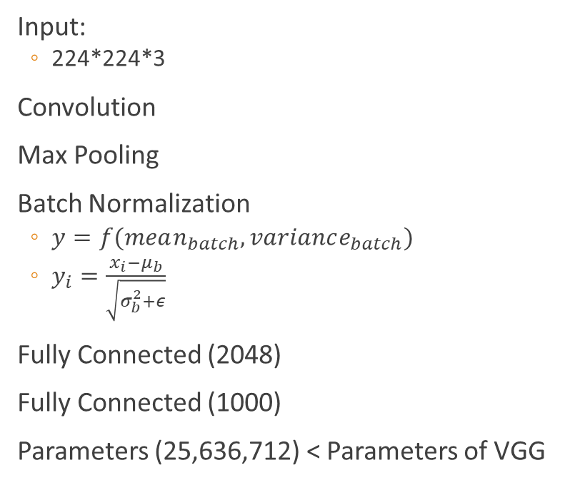
ResNet
Kaiming He (2015)
ILSVRC 2015 classification competition (ImageNet)
MS COCO segmentation in the ILSVRC & COCO competitions of 2015
ResNet
34 Layered
50 Layered
101 Layered
152 Layered
Input:
224*224*3
Convolution
Max Pooling
Batch Normalization
$y=f(mean_{batch},variance_{batch})$
$y_{i}=\frac{x_{i}−μ_{b}}{\sqrt{σ_{b}^{2}+ε}}$
Fully Connected (2048)
Fully Connected (1000)
Parameters (25,636,712) < Parameters of VGG

Slide 33
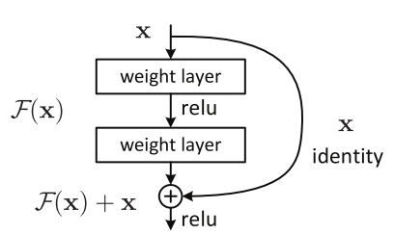
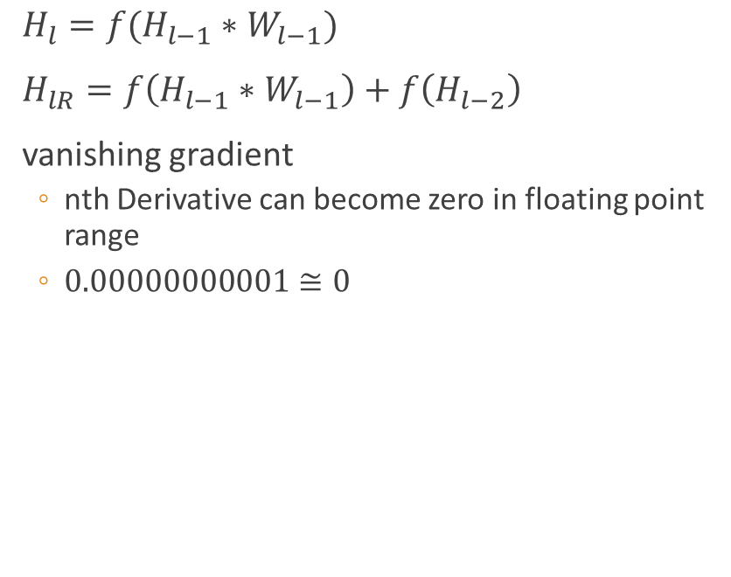
Residual Block
$H_{l}=f(H_{l−1}∗W_{l−1})$
$H_{lR}=f\left(H_{l−1}∗W_{l−1}\right)+f\left(H_{l−2}\right)$
vanishing gradient
nth Derivative can become zero in floating point range
$0.00000000001≅0$
Source: Towards data science

Slide 34
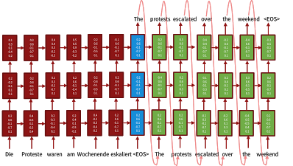
Language Translation (2016)
Sequence-to-sequence models with LSTMs and attention

Slide 35
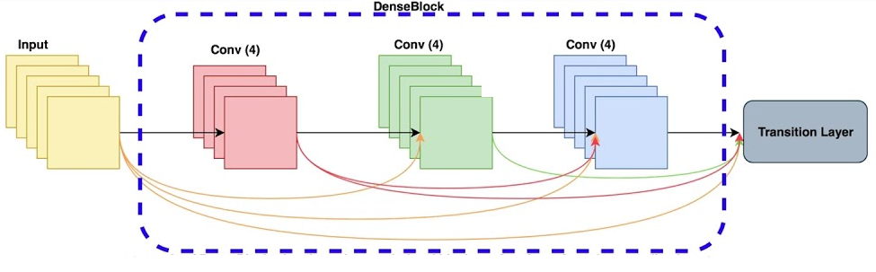
DenseNet
G Huang (2017)
NetWork of the Networks

Slide 36
Image Classification DL Models
Model | Size (MB) | Top-1 Accuracy | Top-5 Accuracy | Parameters | Depth | Time (ms) per inference step (CPU) | Time (ms) per inference step (GPU)
Xception | 88 | 0.790 | 0.945 | 22,910,480 | 126 | 109.42 | 8.06
VGG16 | 528 | 0.713 | 0.901 | 138,357,544 | 23 | 69.50 | 4.16
VGG19 | 549 | 0.713 | 0.900 | 143,667,240 | 26 | 84.75 | 4.38
ResNet50 | 98 | 0.749 | 0.921 | 25,636,712 | - | 58.20 | 4.55
ResNet101 | 171 | 0.764 | 0.928 | 44,707,176 | - | 89.59 | 5.19
ResNet152 | 232 | 0.766 | 0.931 | 60,419,944 | - | 127.43 | 6.54
ResNet50V2 | 98 | 0.760 | 0.930 | 25,613,800 | - | 45.63 | 4.42
ResNet101V2 | 171 | 0.772 | 0.938 | 44,675,560 | - | 72.73 | 5.43
ResNet152V2 | 232 | 0.780 | 0.942 | 60,380,648 | - | 107.50 | 6.64

Slide 37
Image Classification DL Models
Model | Size (MB) | Top-1 Accuracy | Top-5 Accuracy | Parameters | Depth | Time (ms) per inference step (CPU) | Time (ms) per inference step (GPU)
InceptionResNetV2 | 215 | 0.803 | 0.953 | 55,873,736 | 572 | 130.19 | 10.02
MobileNet | 16 | 0.704 | 0.895 | 4,253,864 | 88 | 22.60 | 3.44
MobileNetV2 | 14 | 0.713 | 0.901 | 3,538,984 | 88 | 25.90 | 3.83
DenseNet121 | 33 | 0.750 | 0.923 | 8,062,504 | 121 | 77.14 | 5.38
DenseNet169 | 57 | 0.762 | 0.932 | 14,307,880 | 169 | 96.40 | 6.28
DenseNet201 | 80 | 0.773 | 0.936 | 20,242,984 | 201 | 127.24 | 6.67
NASNetMobile | 23 | 0.744 | 0.919 | 5,326,716 | - | 27.04 | 6.70
NASNetLarge | 343 | 0.825 | 0.960 | 88,949,818 | - | 344.51 | 19.96

Slide 38
Image Classification DL Models
Model | Size (MB) | Top-1 Accuracy | Top-5 Accuracy | Parameters | Depth | Time (ms) per inference step (CPU) | Time (ms) per inference step (GPU)
EfficientNetB0 | 29 | - | - | 5,330,571 | - | 46.00 | 4.91
EfficientNetB1 | 31 | - | - | 7,856,239 | - | 60.20 | 5.55
EfficientNetB2 | 36 | - | - | 9,177,569 | - | 80.79 | 6.50
EfficientNetB3 | 48 | - | - | 12,320,535 | - | 139.97 | 8.77
EfficientNetB4 | 75 | - | - | 19,466,823 | - | 308.33 | 15.12
EfficientNetB5 | 118 | - | - | 30,562,527 | - | 579.18 | 25.29
EfficientNetB6 | 166 | - | - | 43,265,143 | - | 958.12 | 40.45
EfficientNetB7 | 256 | - | - | 66,658,687 | - | 1578.90 | 61.62

